Slide 1
48024 Applications Programming
Dr Angela Huo

Slide 2
EFS Survey
The online Early Feedback Survey (EFS) for Autumn session is now open for student feedback.
https://www.sfs.uts.edu.au/
Survey ID: 251287 | Applications Programming (48024) | Class: SEM1.01 | Teacher(s): Angela Huo | Early Feedback Survey | Learning Mode(s): | Survey opens: 01/04/2019 | Survey ends: 08/04/2019
Survey ID: 251288 | Applications Programming (48024) | Class: SEM1.02 | Teacher(s): Angela Huo | Early Feedback Survey | Learning Mode(s): | Survey opens: 01/04/2019 | Survey ends: 08/04/2019

Slide 3
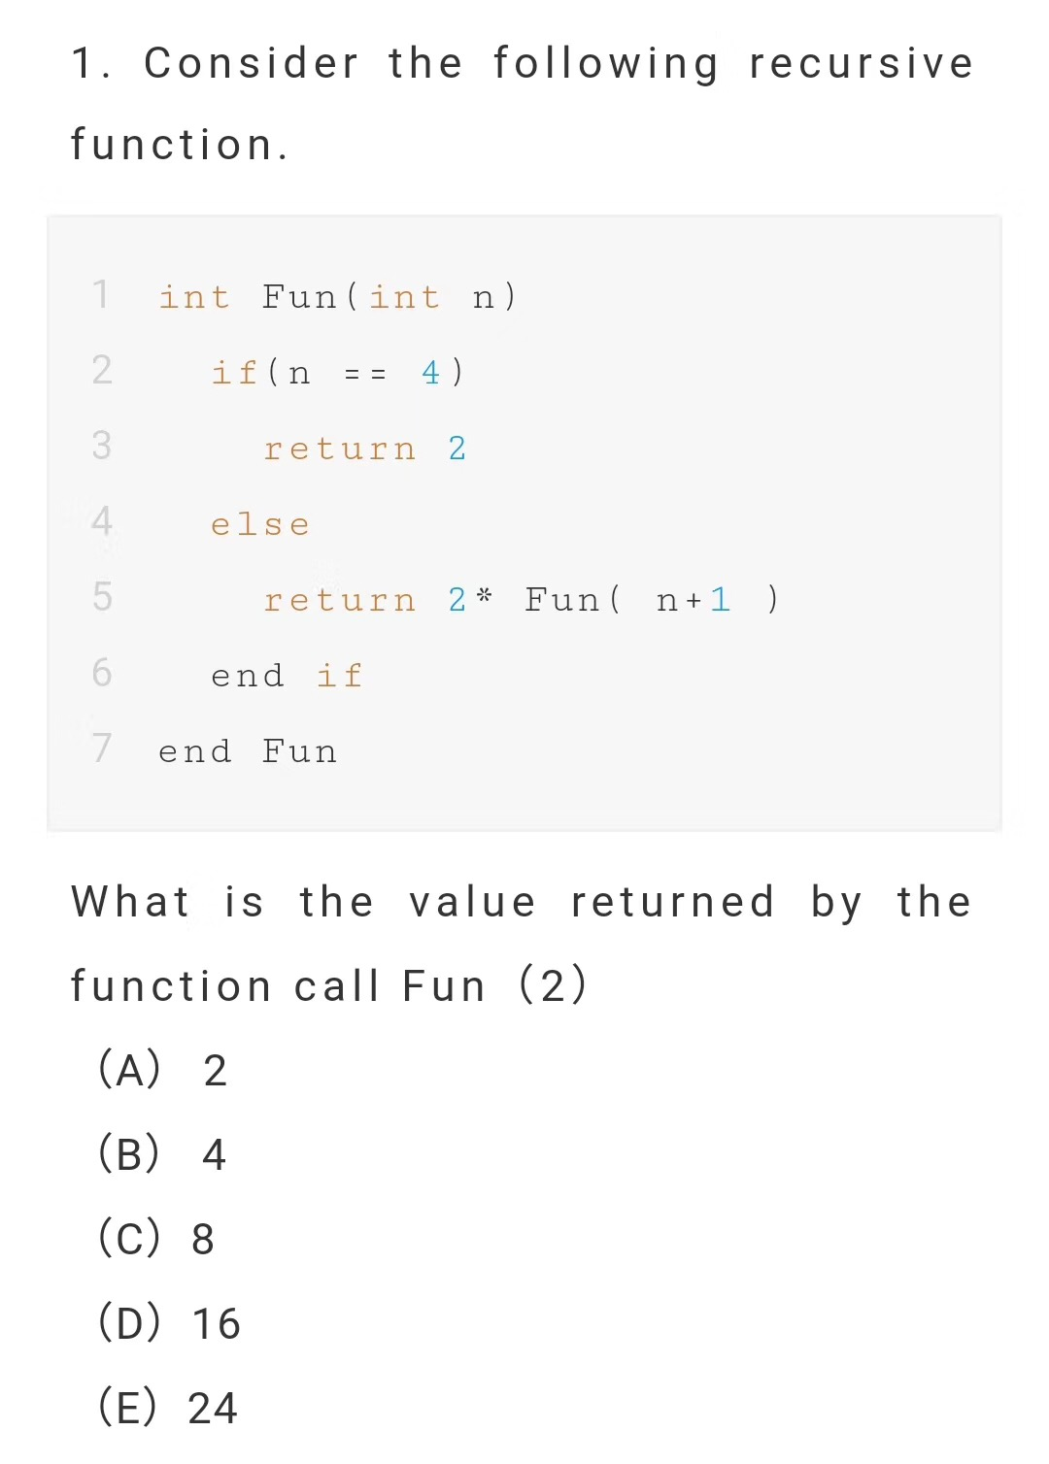
n=4 Fun(4)=2
n=3 Fun(3)=2*Fun(4)=2*2=4
n=2 Fun(2)=2*Fun(3)=2*4=8
n=1 Fun(1)=2*Fun(2)=2*8=16
n=0 Fun(0)=2*Fun(1)=2*16=32
n=5?

Slide 4
Frequently Asked Questions
Can I have more tutoring?
- Lab Monitor
- Friday afternoon 13:00-17:00PM (except week3, 6 and 7)
FLP (CB11.05.300)
Can I have more exercise?
- Lynda.com
- Codecademy
- HackerRank
Can I have more time?
- Time is like a sponge!

Slide 5
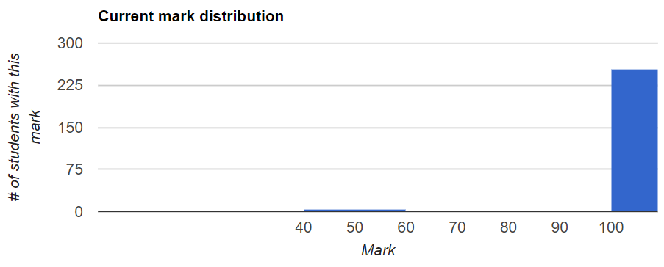
Lab 3 Review

Slide 6
Lab3 Review
Incremental Goals
Top-Down & Bottom-up
Each line contains symmetric positive numbers
Column increases with line increases
The value in the middle equals to the sum of the upper two values
Notes:
In computer science, divide and conquer is an algorithm design paradigm based on multi-branched recursion. A divide and conquer algorithm works by recursively breaking down a problem into two or more sub-problems of the same or related type, until these become simple enough to be solved directly. The solutions to the sub-problems are then combined to give a solution to the original problem.——Wikipedia
---------------------
作者：wzp1421166369
来源：CSDN
原文：https://blog.csdn.net/wzp1421166369/article/details/78648742
版权声明：本文为博主原创文章，转载请附上博文链接！

Slide 7
Side Value
1 void BasicYangHui(void)
2 {
3 int dwRow = 0, dwCol = 0, aTriVal[MAX_ROW][MAX_COL] = {{0}};
4
5 for(dwRow = 0; dwRow < MAX_ROW; dwRow++)
6 {
7 aTriVal[dwRow][0] = aTriVal[dwRow][dwRow] = 1; //if byside，set the value as 1
8 }
9

Slide 8
Inside Value
10 for(dwRow = 2; dwRow < MAX_ROW; dwRow++)
11 {
12 for(dwCol = 1; dwCol < dwRow; dwCol++) //otherwise，sumup the shoulder values
13 aTriVal[dwRow][dwCol] = aTriVal[dwRow-1][dwCol-1] + aTriVal[dwRow-1][dwCol];
14 }
15

Slide 9
Output
16 //Output
17 for(dwRow = 0; dwRow < MAX_ROW; dwRow++)
18 {
19 for(dwCol = 0; dwCol <= dwRow; dwCol++)
20 {
21 printf("%5d", aTriVal[dwRow][dwCol]);
22 }
23 printf("\n");
24 }
25 }

Slide 10
Lab 4
Pattern Book:
there should be quite a few new patterns in your books this week.
Patterns are not always spelled out as such in the lecture notes, and you should write it down if it looks like a pattern (merged read loop)
Topic:
Last week is all about breaking away from patterns and thinking up new solutions.
This week: functions vs procedures, and the break it down, build it up approach. You break it down in a table, and you build it up in code.

Slide 11
PLATE
PLATE still uses Java 8. If something works in BlueJ but not when they submit it to PLATE, this is probably the cause. Therefore, it’s best stick to the string loop pattern and not try something like: for (String c : word.split(“”)).

Slide 12
Timing
30 min Intro + Demo
10 min Form a group, do the levels/goals
30-50 minutes -- Groupwork
Remaining time -- Coding
See you next week!

Slide 13
Contact
Subject Coordinator and Lecturer: Angela Huo
Email: huan.huo@uts.edu.au
Contact information on UTSOnline

